Slide 1
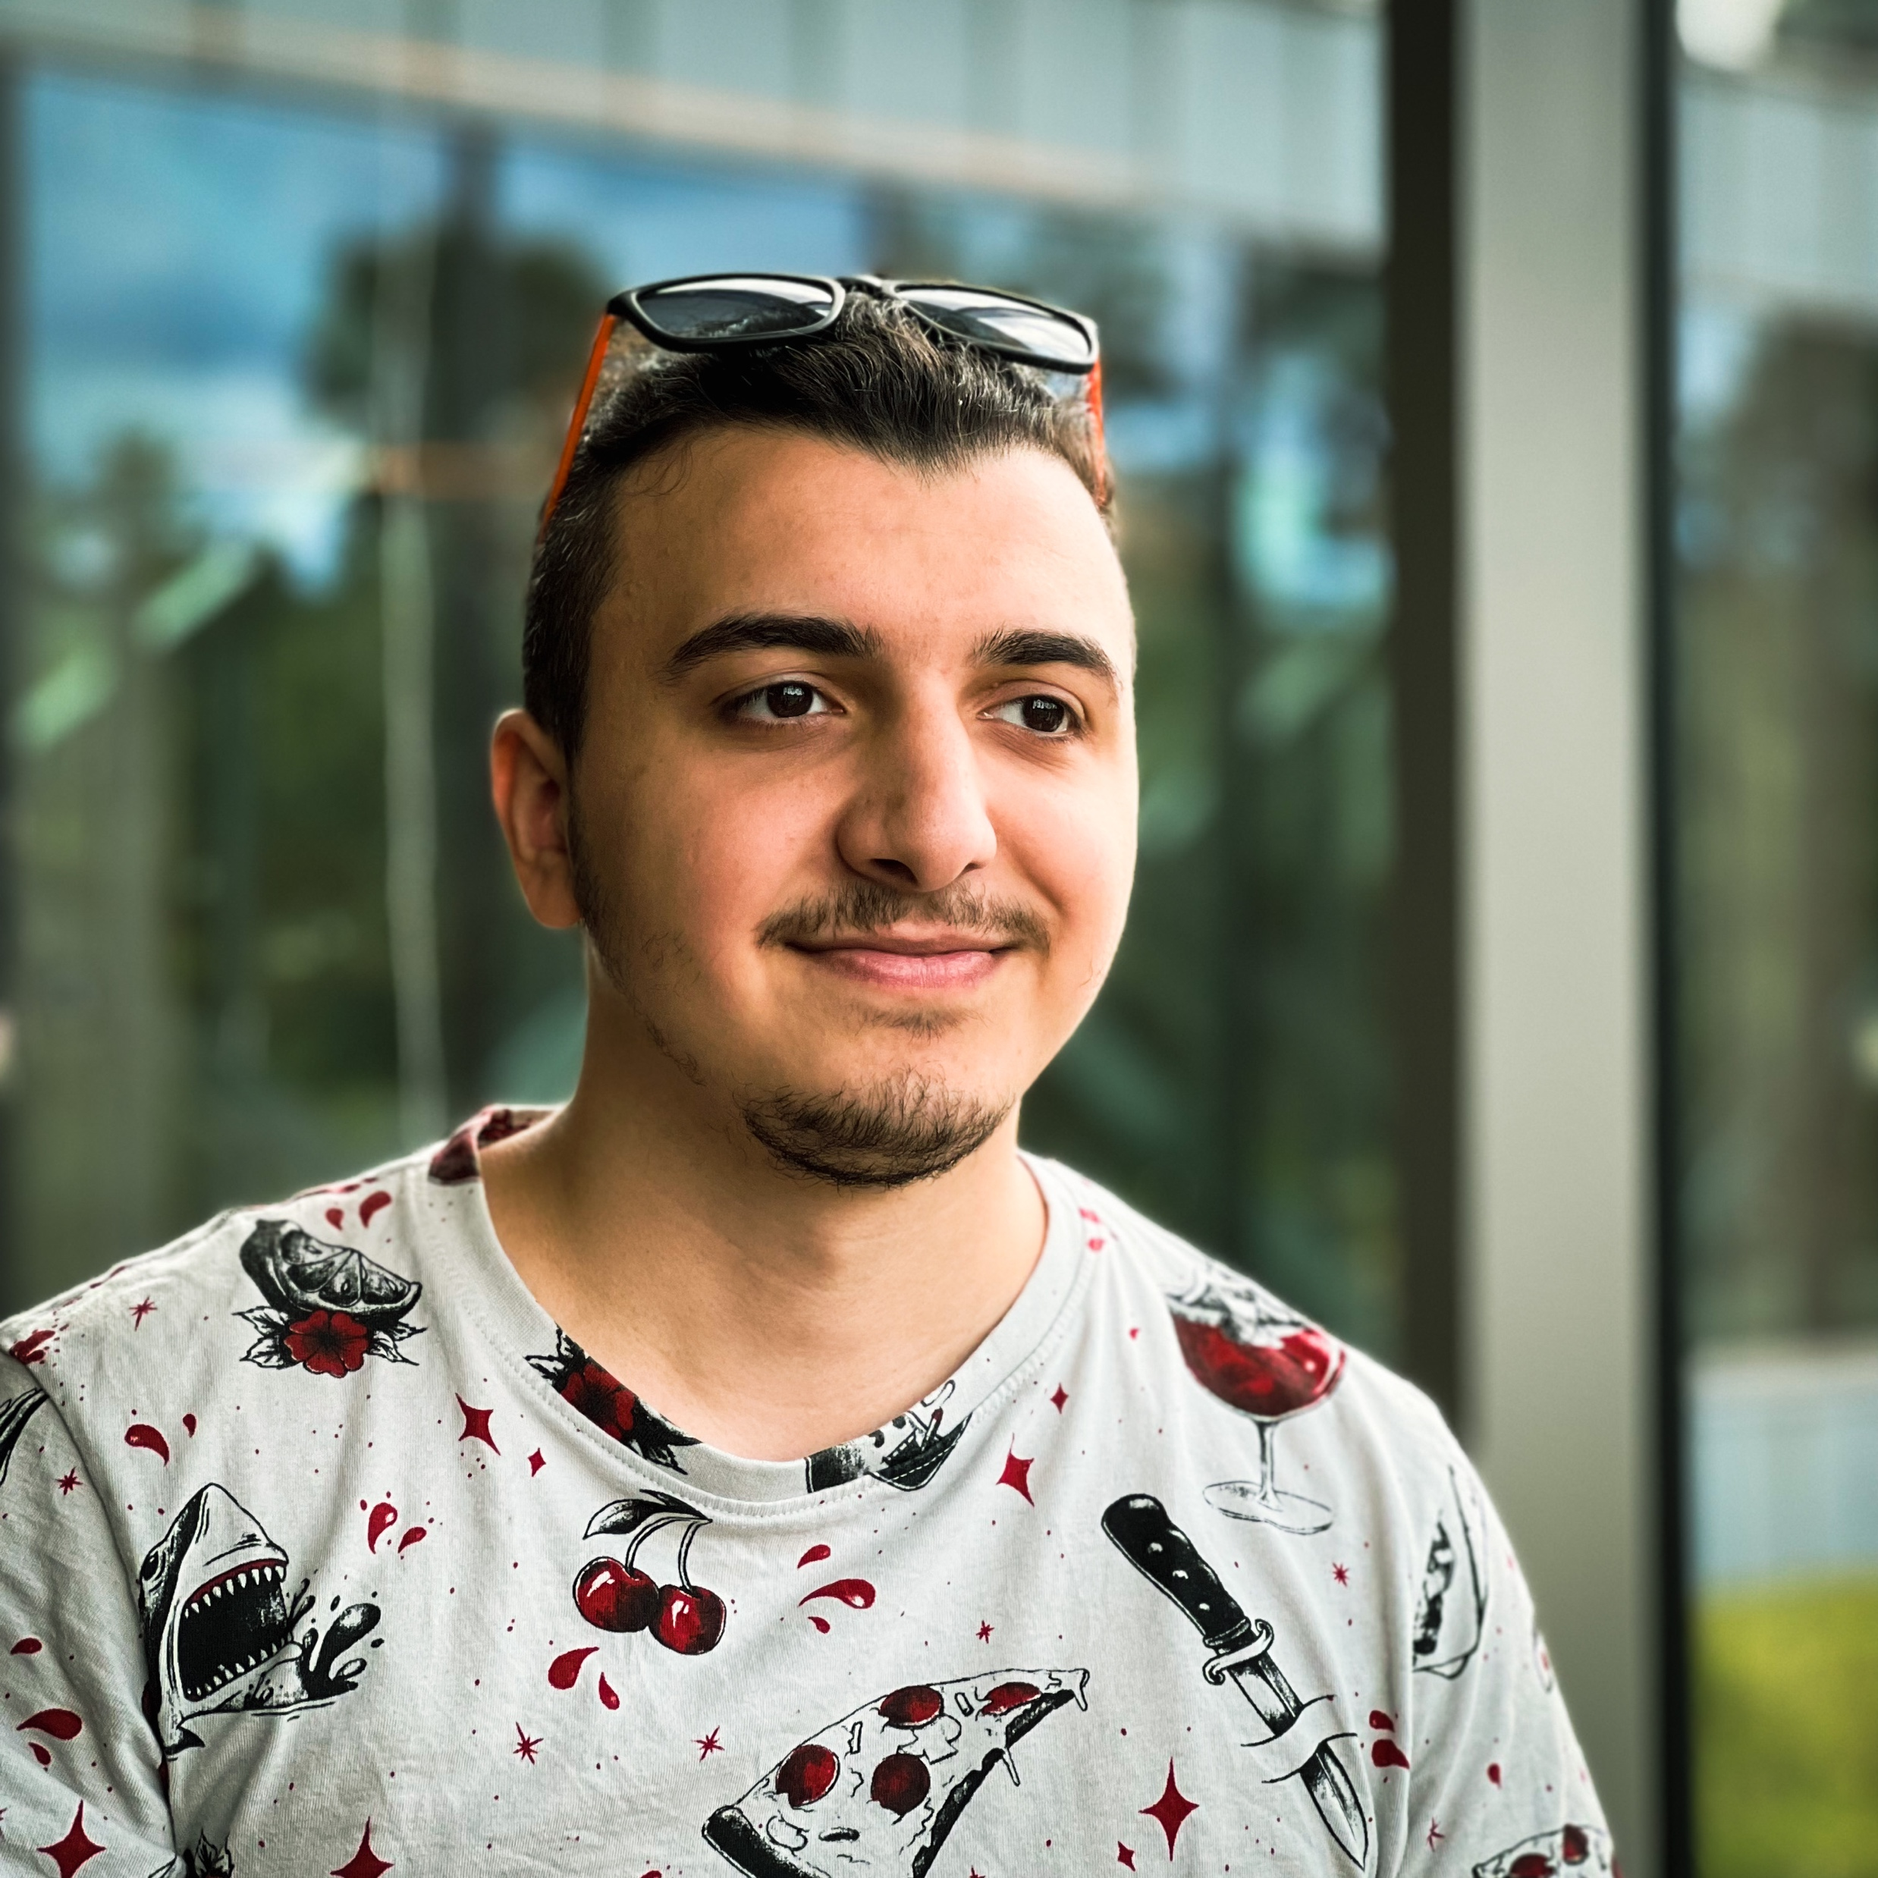
Tural Hajiyev
Software Developer

Slide 2

About
I am a qualified Software Developer who specialized in frontend technologies but also has a solid background in mobile development.
~6
years of experience
I have started my journey as a System administrator and currently continuing as a Software Developer
+25
companies
During my career, I had a chance to work with many customers and see different teams and work cultures

Slide 3
Azerbaijan State Oil and Industry University
2016-2020
Information Technologies and Management
Education
Wroclaw University of Science and Technology
2022-2023
Computer Engineering | Internet Engineering

Slide 4
2016 - 2018
Total IT | Baku, Azerbaijan
Plan and build network systems for different companies
Work experience
Prospect SMB | Baku, Azerbaijan
2020 - 2021
Design and build ERP projects
2022 - now
10BE5 | London, UK
Work on automating the drafting of capital markets.

Slide 5
Designing and planing complex systems and applications
Technical skills
Documenting and testing existing applications, working on future features
Learning new technologies and tools from the first source

Slide 6
Communication
Good communication skills w/ every member of the team that I’m working
Soft skills
Based on my previous experiences, I can divide complex software problems and issues into small chunks and work with my team to fix them
Problem-solving
Time management
Proper estimations and deadlines for planned works, iterations and milestones.

Slide 7
THANKS
For more information, visit tural.dev

